Slide 1
MORE Matrices
Summarizing and reconfiguring

Slide 2
Eigenvalues and Eigenvectors
The Eigenvalue/vector decomposition process takes a matrix and breaks it down into pieces based on existing patterns.
It takes numbers in n-dimensional space and reconfigures them into multiple one-dimension approximations

Slide 3
Eigenvalues and Eigenvectors
Similar mathematical processes (e.g., singular value decomposition) are widely used to find patterns in large amounts of data
Google searches (or most internet searches)
Netflix recommendation algorithms
Reducing pixels in picture compression

Slide 4



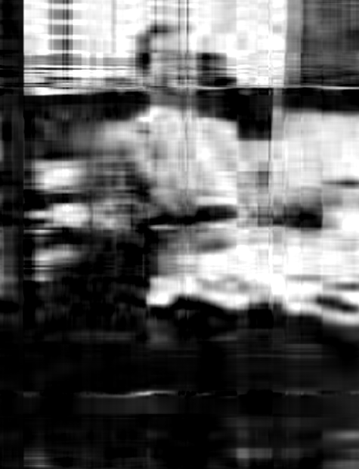

Eigenvalue/vector decomposition
Original Picture
400 Row Vectors
1 Eigenvector
2 Eigenvectors
10 Eigenvectors
50 Eigenvectors
Using only 50 unique vectors the picture is mostly captured
Example taken from Jason Liu’s explanation at https://www.quora.com/What-is-an-intuitive-explanation-of-singular-value-decomposition-SVD.
NOTE: Singular value decomposition is a special case of eigenvalue decomposition where the original vectors undergo a special pre-treatment (i.e., orthonormalization)

Slide 5
Eigenvalues and Eigenvectors
this is a way of rearranging and consolidating the information in a matrix
It is defined as:

Slide 6
Eigenvalues and Eigenvectors
Think of it as taking a matrix and allowing it to be represented by a scalar and a vector (actually a few scalars and vectors, because there is usually more than one solution).

Slide 7
Eigenvalues and Eigenvectors
Another way to look at this is:

Slide 8
Eigenvalues and Eigenvectors

Slide 9
Eigenvalues and Eigenvectors: Example

Slide 10
Eigenvalues and Eigenvectors: Example
Using the first eigenvalue we solve for its corresponding eigenvector

Slide 11
Eigenvalues and Eigenvectors: Example
Using the second eigenvalue we solve for its corresponding eigenvector

Slide 12
Eigenvalues and Eigenvectors: Example
Let’s show that the original equation holds

Slide 13
Eigenvalues and Eigenvectors

Slide 14
Eigenvalues and Eigenvectors

